Slide 1
Bring On The Bots! Microsoft Bot Framework
Gabrielle Crevecoeur
Kevin Leung
Technical Evangelists | Full-time Hackers
https://aka.ms/MHacksChatBot

Slide 2

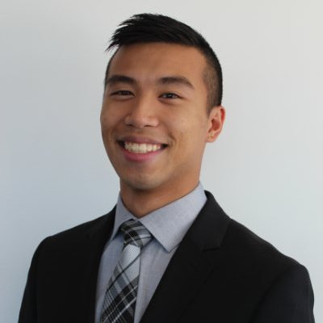
We’re here to help! – Follow Us!
Gabrielle Crevecoeur @NoWaySheCodes
Florida State Seminole – #1 team in America
Hardware enthusiast – NodeBot pro
Kevin Leung @KSLHacks
Electrical and Computer Engineer – Rutgers Engineering
Hackathoner! Huge opportunity – Take advantage!
#FeedKevin *Bonus Points*

Slide 3
How do you Bot? Let’s see what's possible.

Slide 4
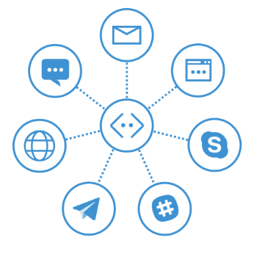
Why Conversation as a Platform?
Hardware Bot
AI Bot
Conversation Bot!
“Microsoft CEO Satya Nadella says future belongs to bots”
“Bots are the new apps,” said Nadella during a nearly three-hour keynote here that sketched a vision for the way humans will interact with machines. “People-to-people conversations, people-to-digital assistants, people-to-bots and even digital assistants-to-bots. That’s the world you’re going to get to see in the years to come.”
- USA TODAY

Slide 5
So what can Bots do?... Make you pizza!

Slide 6
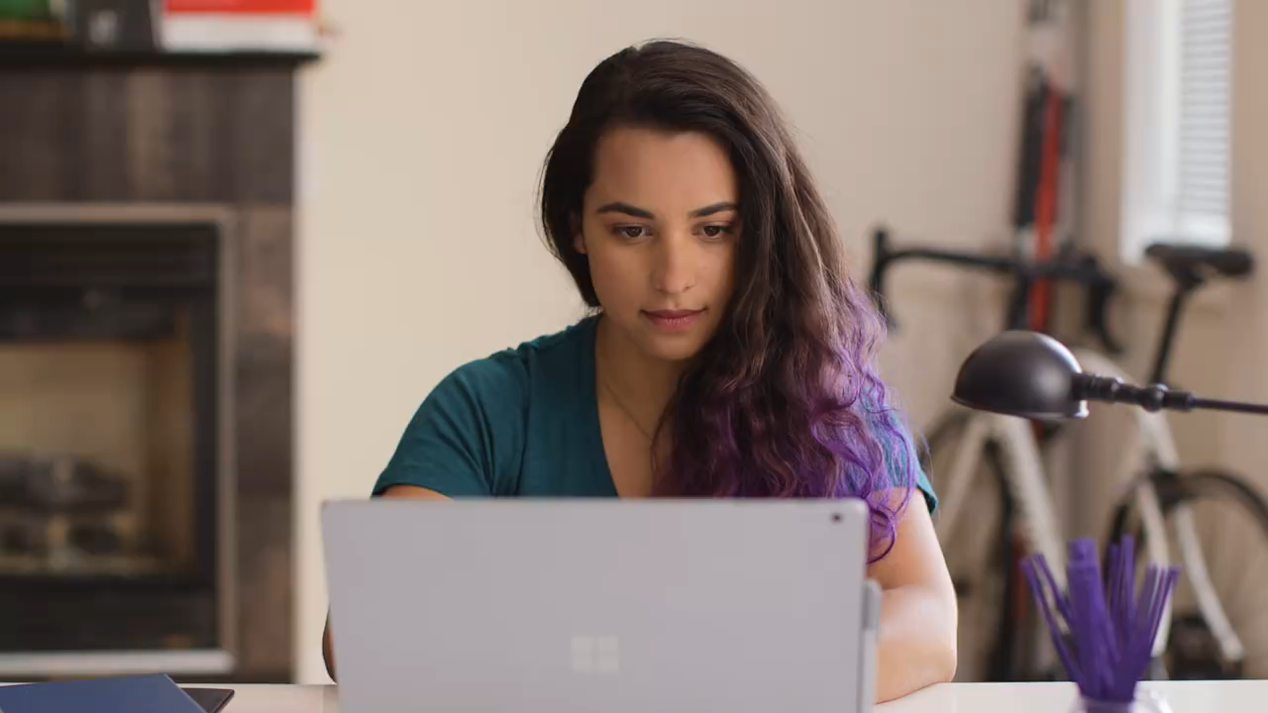

Slide 7
Language and Platforms. Connector Bots.

Slide 8
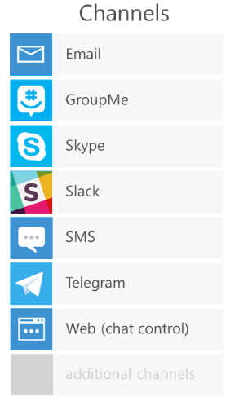

( C# || Node.js )… and Platform Channels
Both easy to implement and have great documentation.
Our Demos will be using Node.js
If you’re more familiar with C# we can help with that too!
Your Bot
(C# or Node.js)

Slide 9
What will I need to start? Prerequisites and Resources.

Slide 10
Gather Your Resources!
Stop by the Microsoft booth for an Azure Code!
Download Node – Click Me! (not required for C#)
Download the Microsoft Bot Emulator – Click Me!
Any Text Editor.
Documentation & GitHub Repo:
https://docs.botframework.com/en-us/
https://aka.ms/MHacksChatBot
Slides and Code Available

Slide 11
Setting Up ChatBot!
Go to http://portal.azure.com
Create WebApp
Find your endpoint URL
Register Your Bot
Configure Web App Settings

Slide 12
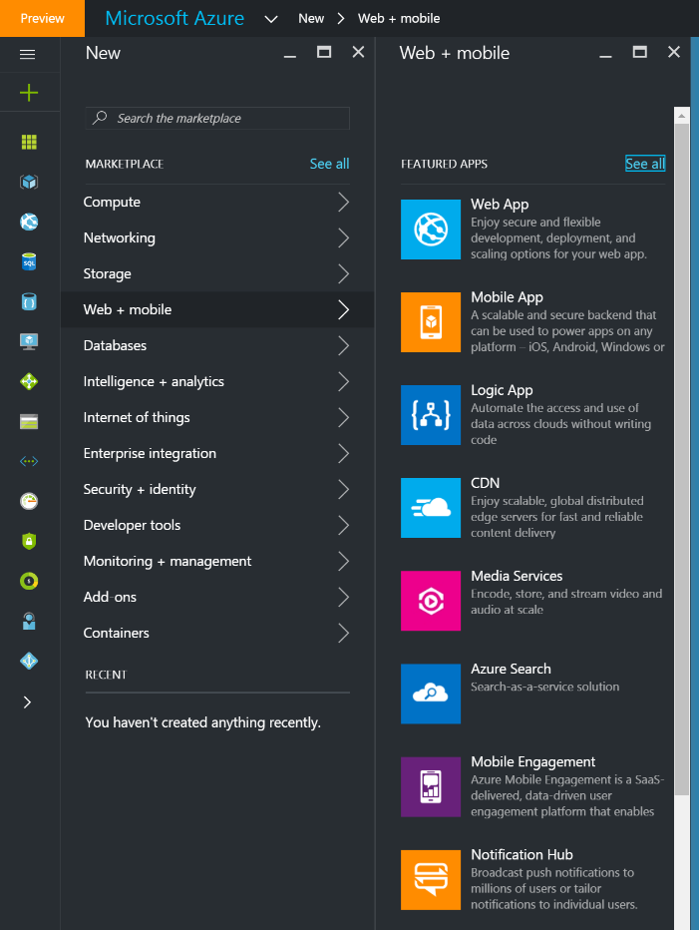
1. Setting Up With Azure
Go to http://portal.azure.com
‘New’
‘Web + mobile’
‘Web App’

Slide 13
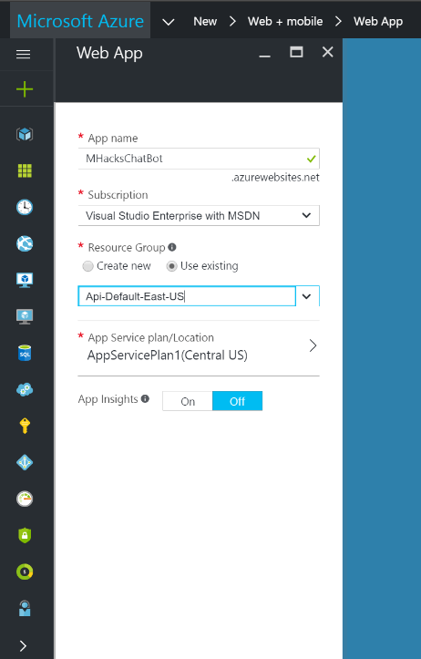
2. Setting Up With Azure
App name
Subscription: ‘Free Trial’
Resource Group: Default
App Service Plan: Create Default
Click “Create”

Slide 14
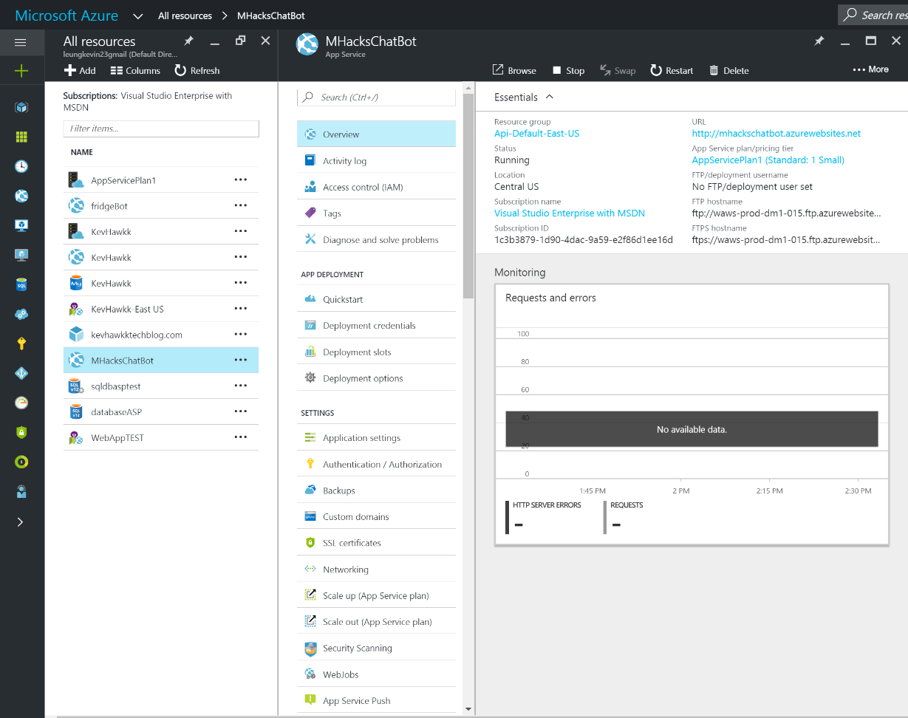
3. Find your endpoint URL
Once your Web App is created..
‘All Resources’
‘<Web App>’
‘Overview’
Save URL !

Slide 15
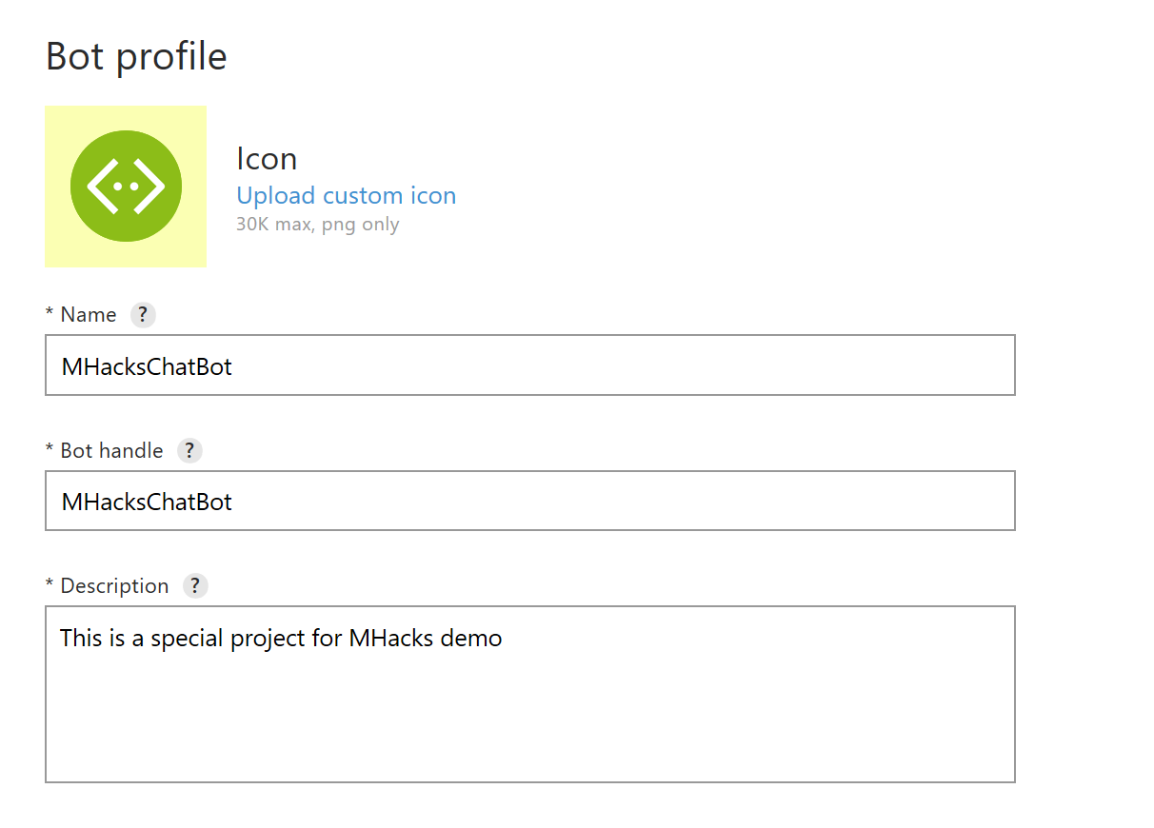
4. Register Your Bot
Go to http://dev.framework.com/bots/new

Slide 16
4. Register Your Bot
Message Endpoint
This is the url of the web app you made in Azure
You must enter it as https NOT http.
Add /api/messages to the end
https://mhackschatbotnode.azurewebsites.net/api/messages

Slide 17
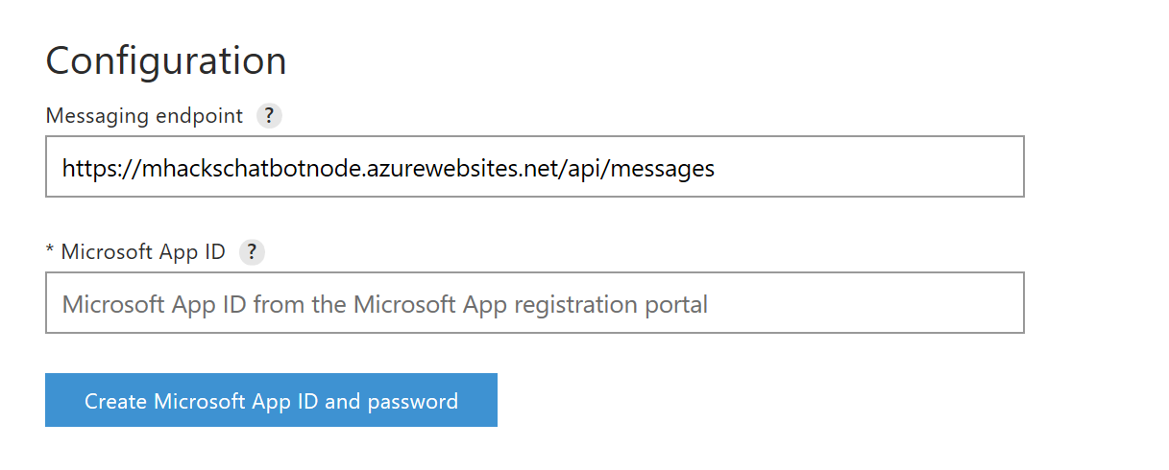
4. Register Your Bot
Generate your Microsoft App Id and App Password
Save your information somewhere, you will need it!
Publisher Profile is about you.
You can use your endpoint url for Privacy Statement & Terms for now. – Must be updated if you wish to publish Bot.

Slide 18
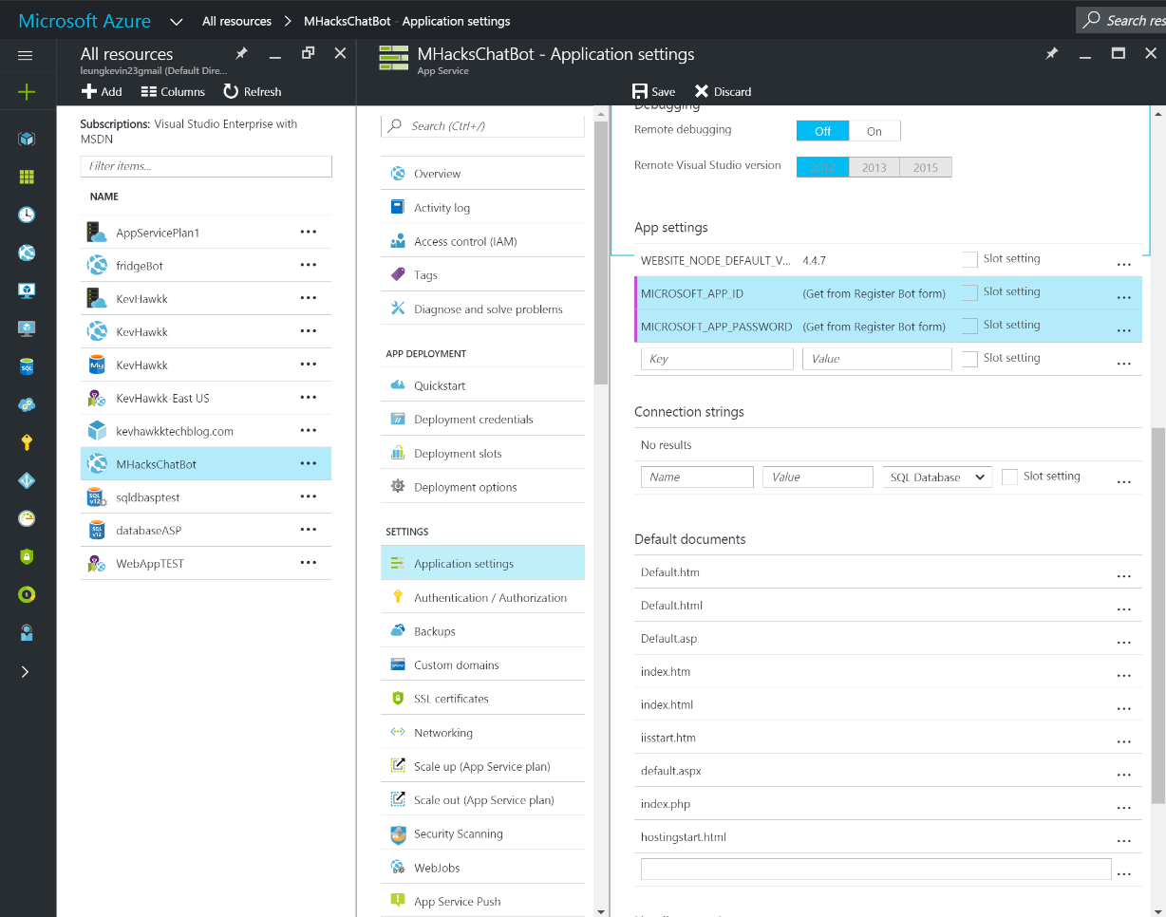
5. Go Back to Azure!
Web App Settings:
MICROSOFT_APP_ID
MICROSOFT_APP_PASSWORD

Slide 19
Finally! Lets get coding! #I<3Code

Slide 20
Setting Up Your Bot Connections
Create a directory (local machine)
Initialize it as a node project
Install proper node modules
Create an app.js file
> npm init
> npm install --save botbuilder
> npm install --save restify

Slide 21
app.js
var restify = require('restify');
var builder = require('botbuilder');
//=========================================================
// Bot Setup
//=========================================================
// Setup Restify Server
var server = restify.createServer();
server.listen(process.env.port || process.env.PORT || 3978, function () {
console.log('%s listening to %s', server.name, server.url);
});
// Create chat bot
var connector = new builder.ChatConnector({
appId: <Your App ID>
appPassword: <Your App Secret>
});
var bot = new builder.UniversalBot(connector);
server.post('/api/messages', connector.listen());

Slide 22
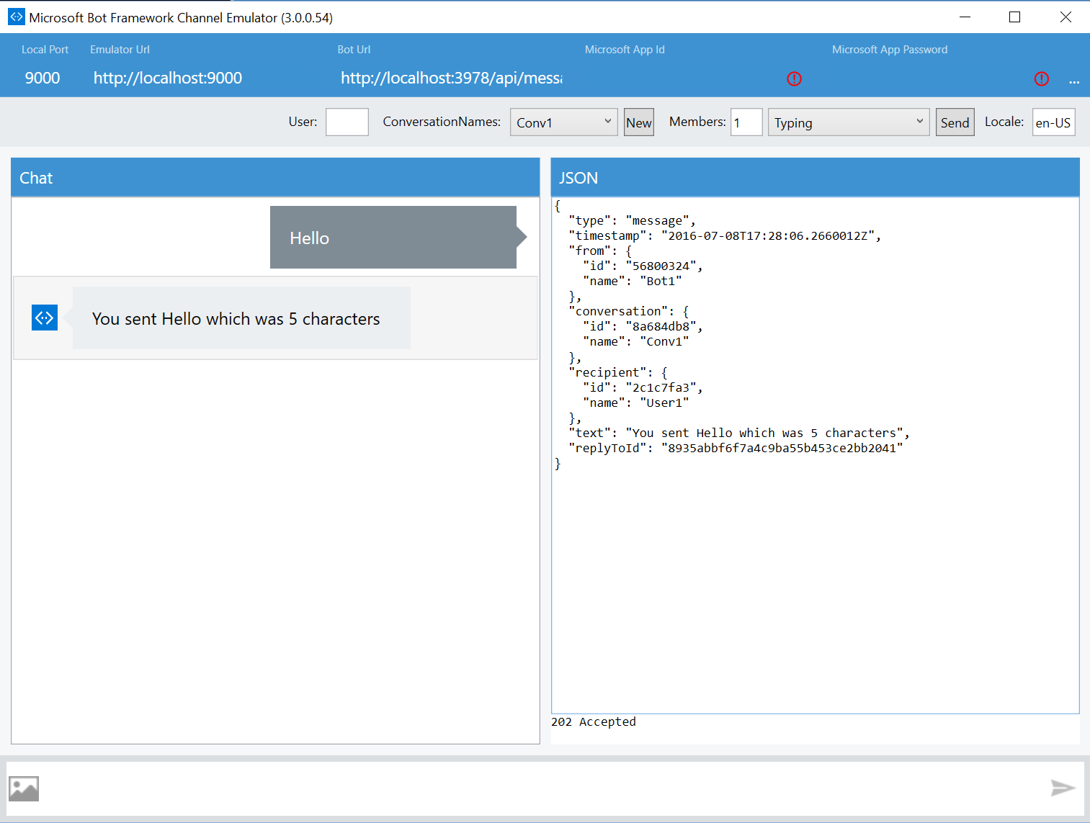
Testing With The Bot Emulator
Register Bot:
- App Id
- App Password
(App Secret)
Double Check Port!
“New” → Session

Slide 23
Dialogs
Used to manage the bots conversation with a user. They are called upon the same way you would call a webpage on a website, routing.
ie. '/' is the root dialog -- which is the first thing the bot will say when the user calls upon it. '/test' is a dialog named test
bot.dialog('/', function (session) {
session.send("Hello World");
});

Slide 24
Continuous Integration
Push your code to GitHub and deploy.
No need to re-deploy every time you make a change!
https://azure.microsoft.com/en-us/documentation/articles/app-service-continuous-deployment/

Slide 25
Conversation Dialogs & Basics Lets Create Some Conversation.

Slide 26
Intents
The IntentDialog class lets you listen for the user to say a specific keyword or phrase..
bot.dialog('/study', new builder.IntentDialog()
.matches(/^ready/i, [
function (session) {
session.send(quiz.Terms[index])
}])
.matches(/^flip/i, [
function(session) {
session. send(quiz.Def[index])
}]
)
…...........
);

Slide 27
Session
The session object is passed to your dialog handlers anytime your bot receives a message from the user. The session object is the primary mechanism you’ll use to manage messages received from and sent to the user.
bot.dialog('/', function (session) {
session.send("Hello! Welcome to the Mhacks Quiz Bot. Would you like to study today?")
session.beginDialog('/user');
});

Slide 28
Waterfalls
Waterfalls are used to let you collect input from the user using a sequence of steps.
bot.dialog('/subject', [
function (session) {
setTimeout(function(){
builder.Prompts.text(session, "What study set would you like today?" + quiz.Sets);
}, 2000)
},
function (session, results) {
quiz.GetTerms(results.response);
session.send("Ok! I got your flashcards! Send 'ready' to begin. Send 'flip' for definition. Send 'next' for the next card. Send 'exit' when you are done")
session.beginDialog('/study')
}]
);

Slide 29
Prompts
The bot framework has built in prompts available that can be used to collect input from a user.
Different return types of prompts available:
builder.Prompts.text(session, "What's your name?");
builder.Prompts.number(session, "How many do you want?");
builder.Prompts.time(session, "When is your appointment?");
builder.Prompts.choice(session, "Which color?", "red|green|blue");

Slide 30
Intents
The IntentDialog class lets you listen for the user to say a specific keyword or phrase..
bot.dialog('/study', new builder.IntentDialog()
.matches(/^ready/i, [
function (session) {
session.send(quiz.Terms[index])
}])
.matches(/^flip/i, [
function(session) {
session. send(quiz.Def[index])
}]
)
…...........
);

Slide 31
Ending Dialogs & Conversations
The session.endConversation() method provides a convenient method for quickly terminating a conversation with a user
The session.endDialog() or session.endDialogWithResults() method will return control back to the caller (popping off the stack.

Slide 32
Intelligent Bots! – Level Up
If ( Kevin.isHungry() ) { Feed(Kevin); } else { DoNotFeed(Kevin); }
If ( Kevin.isHungry() ) { Feed(Kevin); } else { DoNotFeed(Kevin);
FeedAnyway(Kevin); }

Slide 33
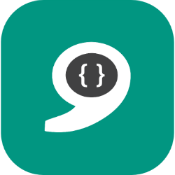
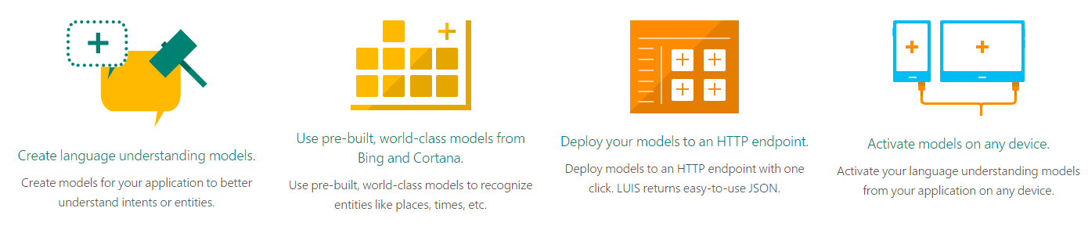
Language Understanding Intelligent Service
https://www.luis.ai/
Part of Microsoft Cognitive Services
Using this will qualify you to win the Microsoft Hack

Slide 34
Language Understanding Intelligent Service
Utterance: A spoken statement, word or vocal sound.
Intent: Specific action or purpose behind a word.
Entity: An instance with an identifiable existence
I want to use Microsoft technology to hack and win a Surface Pro 4.
Intent: toWinMHacks() Entity: sponsor | action | prize

Slide 35
Retaining State Within Conversations
C# [Serializable]
Node.js (sessions)
privateConversationData hold variables unique to the session and can be carried through and referenced. Data is cleared when you send convo.
function (session, results) {
session.privateConversationData.name = results.response;
quiz.GetSets(results.response);
session.endDialogWithResult();
}

Slide 36
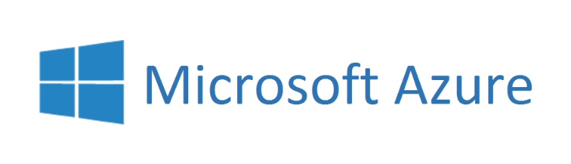


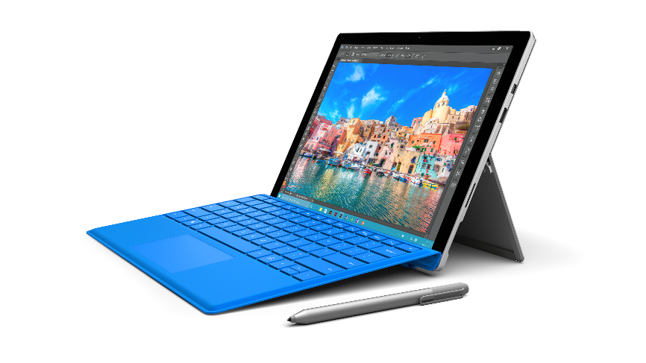



Best Microsoft Hack
Connect with us → mhacks@microsoft.com
Build on 1 or more and Win
aka.ms/azurepasshack
aka.ms/uwp
aka.ms/kinectdev-center
aka.ms/hololensdev-center
Cognitive Services aka.ms/cognitiveservices1
aka.ms/bingdev-center
Visit aka.ms/api.lib for a complete API list and aka.ms/azure.all to see all qualifying cloud services.

Slide 37
Meet Our Team
Connect with us → mhacks@microsoft.com
David Giard
Technical Evangelist
Gabby Crevecoeur
Technical Evangelist
Katie Pinney
University Recruiter
David Washington
Director of Technical Evangelism
Kevin Leung Technical Evangelist
Kristin Naes
Event Planner & Marketing Specialist
Sarah Sexton
Technical Evangelist
Tierney Wixted
Community Evangelist
Yesenia Alvarez
Community Evangelist

Slide 38
Make the Most of Your Experience
Microsoft Hack
Best Overall Use of Microsoft Technology: Surface Pro 4’s for your team (max 4)
Bring on the Bots!
Microsoft Bot Framework - Workshop
Loaners Available
Kinects for Windows
Survey
http://aka.ms/mhacks
Yoga Sessions
Yoga sessions with custom Microsoft & MHacks yoga mats
Join us Saturday at 3:00 PM and learn how to code a chat bot that helps you study, have fun and ace your exams!
Surface Pro 4’s
Prize raffle for GoPro camera and XBOX One
Fanny packs or beanies for the first 200
HoloLens Demo
Sign up to experience the Microsoft HoloLens
Get help hacking and test your HoloLens Hack
Connect with us → mhacks@microsoft.com

